Slide 1
NEF Innovation Awards 2026
Business Plan Template
Project Unique ID: NESIA25_000644
Project Title: Automated Heavy Metal Pollution Index (HMPI) Calculator With Interactive Dashboards And Geospatial Mapping
Name of the College: Dronacharya College of Engineering
City and State: Gurugram, Haryana

Slide 2
 | Name | Mobile Number | Email Address
Principal | Dr. Isha Malhotra | +91 70875 00959 | principal@ggnindia.dronacharya.info
Guide | Dr. Ritu Pahwa | 91+ 9541158333 | hodaiml@ggnindia.dronacharya.info
Participant1 | Royce Kapoor | 91+ 9910180383 | roycekapoor.112@gmail.com
Participant 2 | Lakshit Phougat | 91+ 7827727768 | lakshit.phougat@gmail.com
Participant 3 | Saksham Arora | 91+ 8766314998 | sakshamarora2709@gmail.com
Participant 4 | Vidushi Anand | 91+ 9717049910 | vidushianand09@gmail.com

Slide 3
Team Composition

Slide 4


Slide # 1: What problem we are solving?
  Problem Statement
Raw concentration values of Heavy Metals are difficult to interpret
Pollution severity is not clearly quantified
Manual calculations are time-consuming and error-prone
Existing tools lack built-in prediction capabilities
There is no integrated system combining analysis, mapping, and forecasting
    People being affected by the problem
Researchers – Need faster, repeatable pollution analysis
Environmental agencies – Require clear identification of high-risk zones
Policy Makers – Spend more time processing data than generating insights
The Core GAP:
A unified platform that automates heavy metal pollution analysis, visualizes results geographically & enables future pollution prediction in a simple, scalable way.

Slide 5

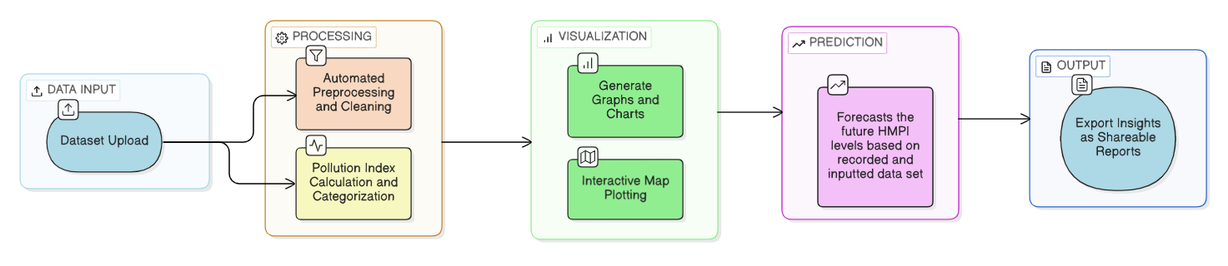
Slide # 2: T he Solution
AquaScan is a web-based geospatial pollution analysis and prediction platform that automates heavy metal data processing and forecasting through a simple and scalable approach.
In Simple Terms…It converts raw heavy metal concentration data into clear pollution levels, visual maps, and future predictions to help researchers and agencies make environmental decisions.

Slide 6
Slide # 3: Customer Profile
Primary Customer
The primary customers are environmental researchers, academic institutions, and government environmental agencies who need accurate, automated heavy metal pollution analysis and forecasting tools.
They face challenges in manual data processing, lack of integrated tools, and absence of predictive environmental insights.
User Types:
Environmental researchers and scientists
Academic institutions and research labs
Environmental consulting firms
Government and municipal environmental monitoring bodies
Age Group
25–60 years (professionals and researchers)
Geography
Regional, national, and international

Slide 7
Slide # 4: Differentiation / Innovation
India-Centric Problem
Rapid industrialization, mining, and agricultural runoff are increasing soil and groundwater contamination. Monitoring agencies lack automated and predictive tools for heavy metal assessment.
Role of AI
AI enables HMPI forecasting, trend detection, and early identification of high-risk zones — transforming monitoring from reactive to proactive.
Data & Real-World Constraints
Designed for structured heavy metal and geospatial datasets, the system handles inconsistent formats and limited historical data common in Indian environmental systems.
What Sets Our Approach Apart
Rather than offering only index computation or static reporting, our platform combines automated HMPI calculation, interactive geospatial mapping, and AI-driven forecasting within a single integrated system.
Ease of Adoption & Accessibility
A web-based interface with simple dataset upload requires no advanced statistical expertise, making it accessible to researchers, institutions, and government agencies.
Scalability & National-Level Impact
Designed to scale from small academic datasets to district and state-wide monitoring programs, enabling data-driven environmental governance and proactive early-warning mechanisms.

Slide 8
Slide # 5: Budget
Development Strategy
Built entirely using open-source technologies (Python, Flask, ML libraries)
Developed in-house — no external development expenditure
Modular and scalable architecture to minimize infrastructure overhead.
Initial Setup Cost (One-Time Investment)
Basic cloud hosting configuration: ₹5,000 – ₹10,000
Domain registration & deployment setup: ₹1,000 – ₹2,000
Testing, validation & pilot optimization: ~₹5,000
Estimated Total Initial Cost: Under ₹20,000
Monthly Operating Cost (Pilot Phase)
Cloud hosting & compute resources: ₹3,000 – ₹6,000
AI forecasting compute (moderate usage): ₹1,000 – ₹3,000
Data storage & system maintenance: ₹500 – ₹1,000
Estimated Monthly Operational Cost: ₹5,000 – ₹10,000

Slide 9

Slide # 6: Revenue Generation (Freemium Model)
Free Features (Open Access)
HMPI calculation
Risk classification (Safe / Moderate / High)
Interactive charts
Geospatial map visualization
Premium AI Features (Token-Based Access)
Future HMPI prediction
AI-based trend forecasting
Time-series visualization
Downloadable AI-based analytical reports
How Will Token System work?
AI-powered forecasting and predictive analytics are available through a token-based system. Users can purchase tokens and then access these features. The number of tokens required is automatically determined based on the size of the uploaded dataset. This ensures a transparent, usage-based pricing approach aligned
Pricing Plans (Initial Phase)
Package | Tokens | Price | Cost per Token
Starter | 50 | ₹499 | ₹9.98
Research | 150 | ₹1,299 | ₹8.66
Institutional | 500 | ₹3,999 | ₹7.99
Government | Custom | Negotiated | Lower bulk rate

Slide 10
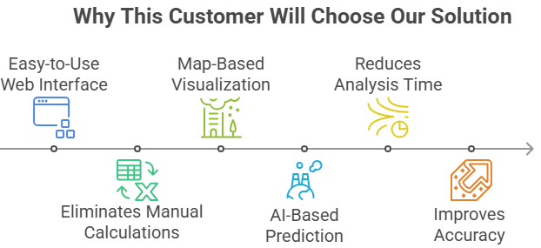
Slide # 8: Market Study
What Other Solutions Exist Today?
Excel / Manual HMPI Calculations – Time-consuming and error-prone
GIS Software (ArcGIS, QGIS) – Provides mapping but no built-in HMPI automation
Statistical Tools (R, MATLAB, SPSS) – Powerful but require technical expertise
Research Publications & Static Reports – Provide historical data, not real-time or predictive tools
Environmental Consulting Services – Expensive and not scalable for repeated analysis

Slide 11
Video of Prototype or Application
Time Limit maximum 1 minutes

Slide 12
Thank You

